Slide 1

VINS-mono + Airsim Weekly connect and updates
Ritvik Pandey
Intern H402743

Slide 2
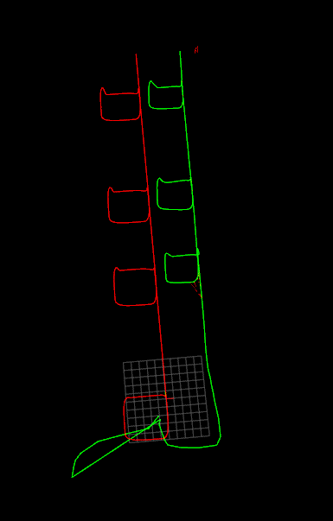
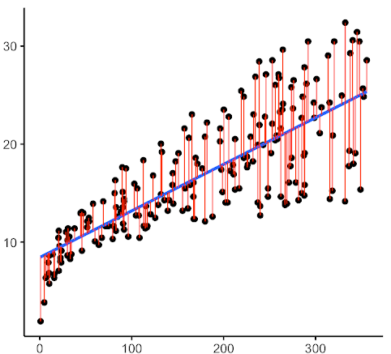

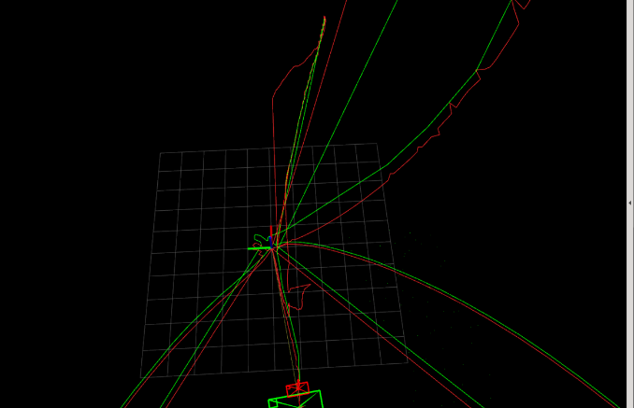
Flow of this presentation
Working pipeline
Package structure and working
Touch on previous concepts
Results from last week
Previous results
Problems related to it
Current stage
Demonstration
Changes made and approach
Tasks now
Problems in approach
New tasks at hand

Slide 3
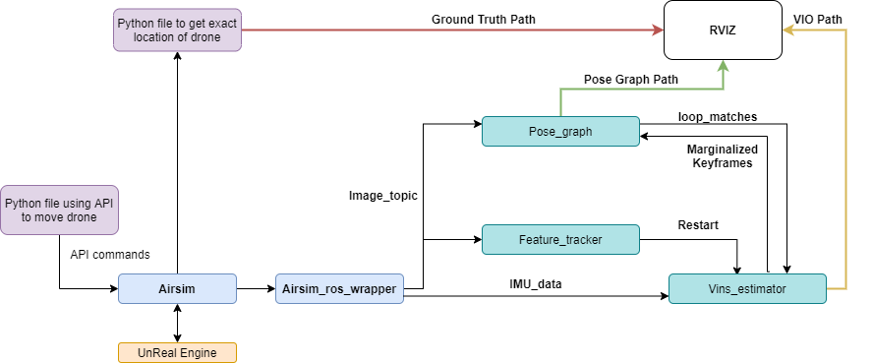
Working Pipeline
VINS-MONO
Notes:
Drone movements in Airsim are controlled by a python module
Another python publisher is used to publish ground truth
Airsim_ros_wrapper publishes image and IMU to VINS-Mono
VIO, pose graph and ground truth are gathered by RVIZ

Slide 4
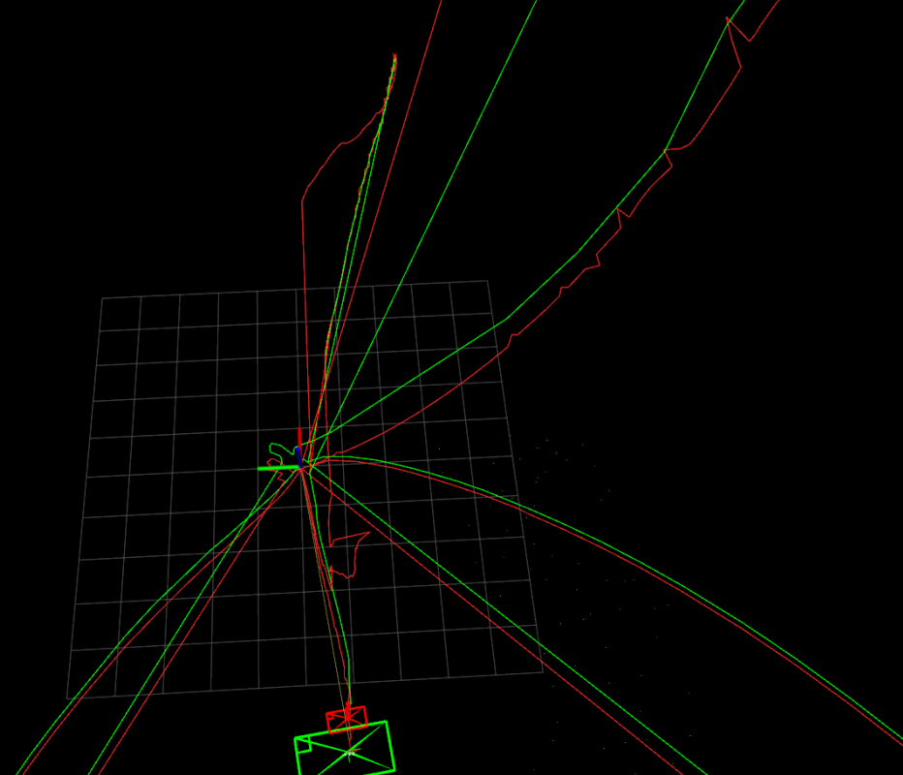
LAST week RESULTS
Red = Pose graph path (global odometry)
Green = VIO path (local odometry)
Ground truth not published
Camera calibration from euroc dataset
Crashes frequently
Wrong Scales (312 vs 32)
Odometry does not have given geometry
Notes:
Drone movements in Airsim are controlled by a python module
Another python publisher is used to publish ground truth
Airsim_ros_wrapper publishes image and IMU to VINS-Mono
VIO, pose graph and ground truth are gathered by RVIZ

Slide 5
Current RESULTS
VIDEOS : 2,3,4
Notes:
Drone movements in Airsim are controlled by a python module
Another python publisher is used to publish ground truth
Airsim_ros_wrapper publishes image and IMU to VINS-Mono
VIO, pose graph and ground truth are gathered by RVIZ

Slide 6
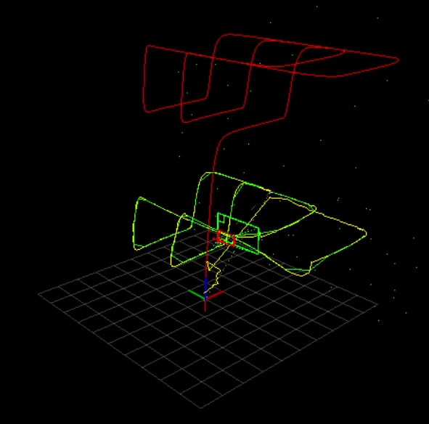
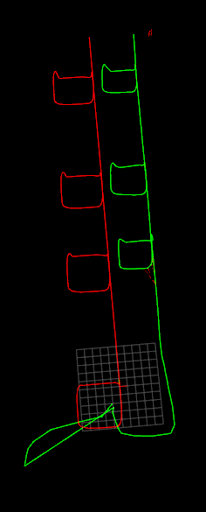
CURRENT STAGE
Red = Ground Truth
Green = Pose graph path (global odometry)
Yellow = VIO path (local odometry)
Good geometrical features
Approximately correct scales
Does not crash after initialization (even if we go through trees and loose all visual features)
Notes:
Drone movements in Airsim are controlled by a python module
Another python publisher is used to publish ground truth
Airsim_ros_wrapper publishes image and IMU to VINS-Mono
VIO, pose graph and ground truth are gathered by RVIZ

Slide 7
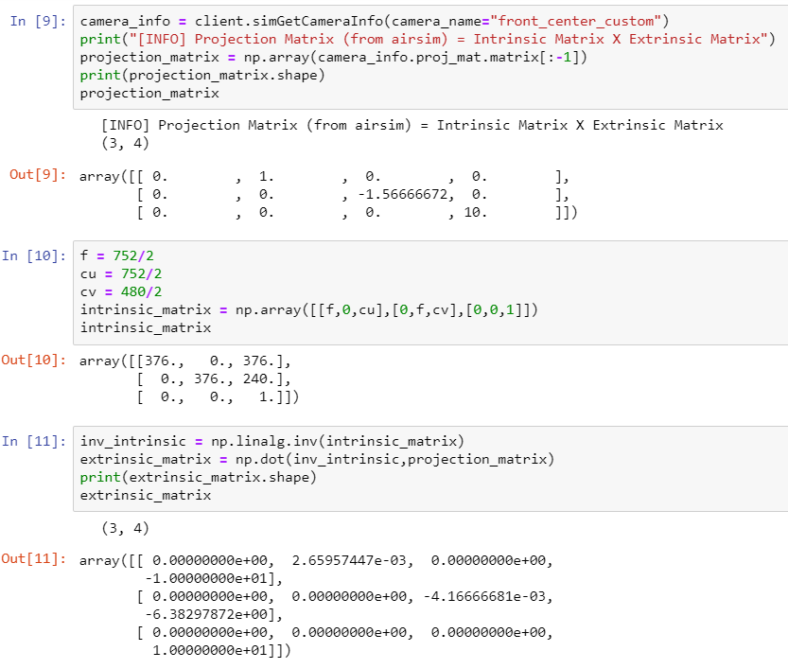
Calibration Matrix
Previous approach:
Unstable initialization
Deviation from co-ordinate axis in terms of translation
Notes:
Drone movements in Airsim are controlled by a python module
Another python publisher is used to publish ground truth
Airsim_ros_wrapper publishes image and IMU to VINS-Mono
VIO, pose graph and ground truth are gathered by RVIZ

Slide 8
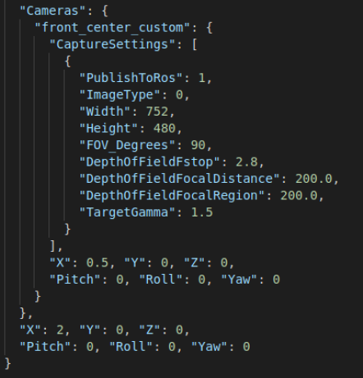
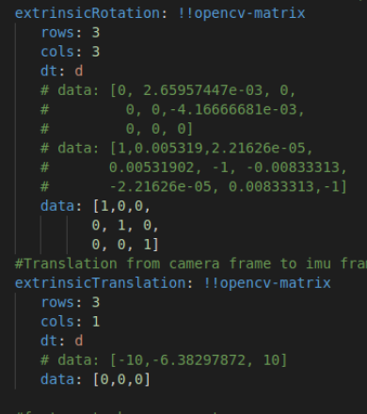
Calibration Matrix
Rechecked using camera info API,
Camera co-ordinates are 0.5,0,0 wrt the body
Camera orientation is also 0,0,0
No information regarding IMU location and orientation given
Current approach:
Much stable initialization
Co-ordinate shift still and changing translation matrix does not help
Notes:
Drone movements in Airsim are controlled by a python module
Another python publisher is used to publish ground truth
Airsim_ros_wrapper publishes image and IMU to VINS-Mono
VIO, pose graph and ground truth are gathered by RVIZ

Slide 9
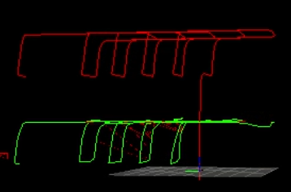
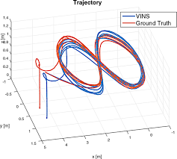
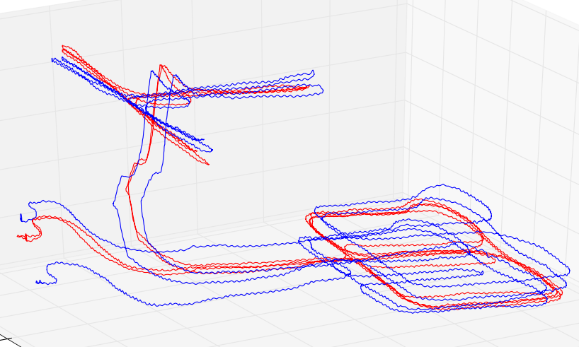
TASKS NOW
Shift in co-ordinate frame
Testing on different path and scenes
Error plots and quantification of error
(RMSE)
To add errors and their solution to the bitbucket repo
Notes:
Drone movements in Airsim are controlled by a python module
Another python publisher is used to publish ground truth
Airsim_ros_wrapper publishes image and IMU to VINS-Mono
VIO, pose graph and ground truth are gathered by RVIZ

